Slide 1
MUSIC PLAYER BASED ON EMOTION RECOGNITION
By
Name: RAVI RANJAN
Enrolment no: 22020002004006
Class roll no:- 128
Under the guidance of
Mr. Swagtam Basu
Department of
Institute of Engineering and Management

Slide 2
Topics Covered:
Progress Report
Problem Definition
Aim & Scope
Methodology
Process
Future Scope
Reference

Slide 3
Progress Report
Semester | Work Done
5 | study to related necessary topic for project(python, machine learning, etc.)
6 | work on basics like how to extract face using python through Haar cascade algo.
7 | Now study the way the model work to further process in project(like CNN model generates)

Slide 4
Problem Definition:
Music plays a very important role in today’s life. Everyone wants to listen music of individual taste and based on their moods.
But User always faces the task of manually browsing the music and to create a playlist based on their moods.
In today’s world, many music player are available with different features like fast forward, reverse, various playback speed, local playback, different genre groups etc.
These features satisfy the user’s basic requirements. Yet the user has manually select the playlist of songs and select songs based on his moods.

Slide 5
Aim & Scope:
My basic approach is to create Emotion based music player that helps user to automatically play songs based on the emotion of the user.
It recognizes the facial emotion of the user based on their Facial Expression.
Humans links the music lyrics from which music they listen and how they feel.
It would be helpful if the music player was “smart enough” to sort out the music based on the current state of emotion the person is feeling.

Slide 6
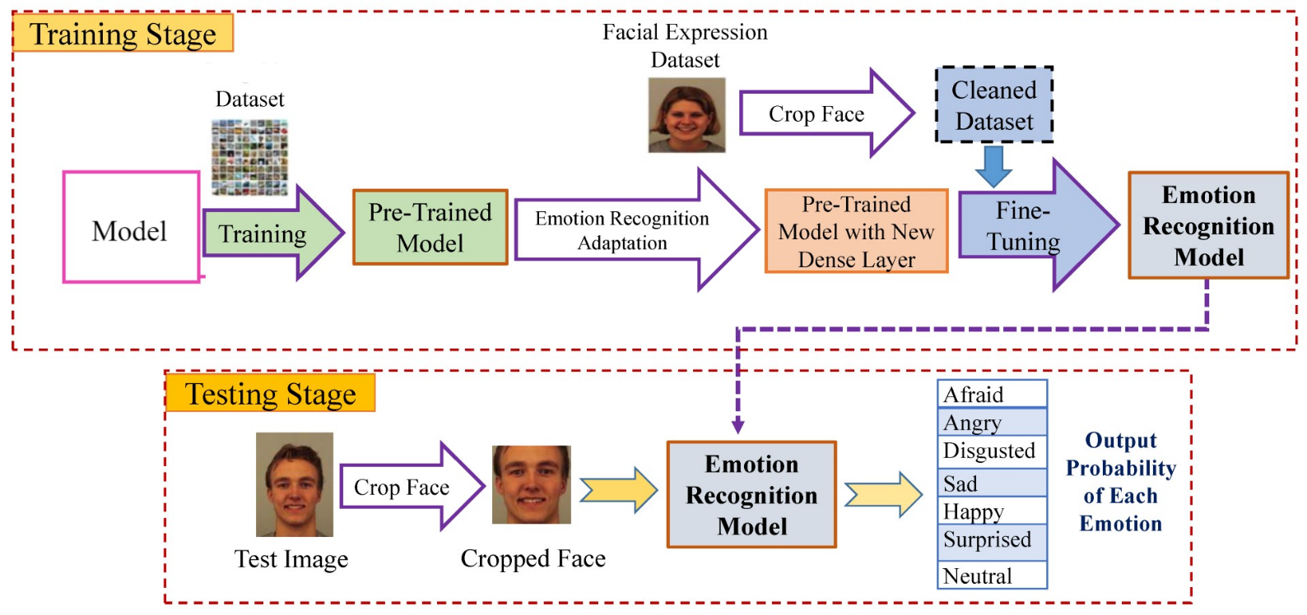
Methodology:
In this project, the webcam captures the image of the user. Then it will extract the human face feature of the user from captures image. After that extract the facial features of the user from captures image. Facial expression categorized into seven different moods (Happy, Sad, Disgust, Fear, Neutral, Angry, Surprise).

Slide 7
Process:-
This project consists of 4 module – faces detection, feature extraction, emotion detection and songs classification.
We use Viola-Jones algorithm which is quite powerful and its application has proven to be exceptionally notable in real-time face detection.
Viola-Jones outlines a box and searches for a face within the box.Before detecting a face, the image is converted into grayscale, since it is easier to work with and there’s lesser data to process. The Viola-Jones algorithm first detects the face on the grayscale image and then finds the location on the coloured image.
Then we used CNN(MobileNet architecture) for feature extraction module and The Viola-Jones Algorithm which is used to detect the presence of face and extract the features needed form a pattern that matches the facial expression. The CNN is trained manually for the classification of 7 emotion states (happy, sad, surprise, angry, disgust, fear, neutral)
During Song Classification Module , we will identify the mapping of each song with its mood. Based on these features, we need to train an artificial neural network which successfully classifies the songs in 7 classes with a higher accuracy . The songs have to manually labelled. All the features will extracted using Python and relevant packages

Slide 8
Future Scope:-
We can use this project as :-
Automatically play song based on the emotion of the user using Spotify API
Smart TV that choose channels or movies web series according to our mood.
Recommendation on YouTube.
Can be used for Blind people which is more convenient for them. They can show their emotion and different application works according to their mood.
Personal Assistant based of Emotion Recognition

Slide 9
Reference
https://ijariie.com/AdminUploadPdf/REALTIME_EMOTION_BASED_MUSIC_PLAYER_USING_IMAGE_PROCESSING_ijariie17839.pdf
https://www.irjet.net/archives/V5/i4/IRJET-V5I41065.pdf
http://www.ijirset.com/upload/2020/june/21_Music_NC.PDF
https://www.mygreatlearning.com/blog/viola-jones-algorithm/#sh3
https://medium.com/analytics-vidhya/image-classification-with-mobilenet-cc6fbb2cd470

